Slide 1

Pupil and Teacher Voice at Primary
Ensuring children and young people have a voice in the development and delivery of their music education

Slide 2

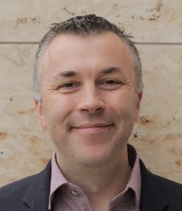
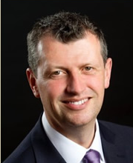
Introductions
Edward Milner
Interim CEO, The Voices Foundation
Simon Toyne
Executive Director of Music, David Ross Education Trust

Slide 3
Workshop Objective
How Voices Foundation and the David Ross Education Trust are impacting on the social, educational and musical outcomes of children and young people, especially in disadvantaged areas, through the voices of their teachers

Slide 4
The Voices Foundation
The Voices Foundation is a national charity which uses the power of singing to improves the lives of children and young people in the UK
We work with schools and Music Hubs to strengthen musical outcomes for children aged 0-18, with a view to their wider development including academic and social learning
Our focus is on strengthening schools from the inside by providing whole staff CPD, thereby equipping teachers with the skills and confidence to deliver musical learning themselves

Slide 5
David Ross Education Trust
The David Ross Education Trust is a network of unique and diverse academies, committed to becoming one of the top-performing multi-academy trusts in the country
Recognised as one of 11 system leaders nationwide, the Trust works with 34 primary and secondary schools across the country
The Trust aims to shape and improve its educational provision through developing the quality and scope of music-making for thousands of young people across both our primary and secondary sectors. This strategy is designed to enable Music to be an integral part of the Trust’s vision to transform young people’s lives

Slide 6
Paul Hamlyn Foundation Teacher Development Fund
Initiative that supports the delivery of effective arts-based teaching and learning opportunities in the primary classroom, and embeds learning through the arts in the curriculum.
Aims to support teachers and school leaders to develop the necessary skills, knowledge, confidence and experience to teach non-arts subjects using arts based approaches.
2-year grant of £150,000 will enable VF and DRET to harness the power of singing to bring about sustainable change for whole schools.
Delivered over 2018-20 academic years in Hull, Grimsby, Northampton and Kettering schools, where a significant number of pupils experience disadvantage.

Slide 7
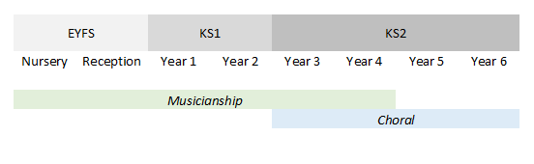
Singing Schools model
Musicianship - Working with all classes from EYFS to Year 4, this strand focusses on teacher training/CPDL, developing musical skills through singing in the classroom.
It engages with UKS2 teachers and support staff through whole staff Twilight training sessions throughout the year and provides additional support and training for Music Curriculum Leader.
Choral – Working directly with KS2 pupils, but with CPDL embedded for your Music Coordinator and any other relevant staff.

Slide 8
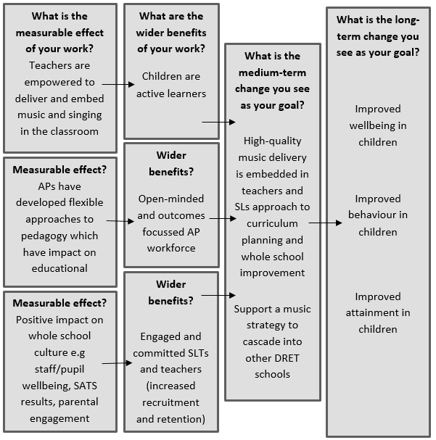
Theory of Change:
An outcomes- focused approach

Slide 9

Educational outcomes
Aim:
To engage school communities with high quality musical learning, acting as an agent for whole school improvement
Intended outcomes:
Increased musical engagement and confidence among pupils and staff (with staff equipped to deliver a progressive, sustainable music curriculum)
Increased leadership, resilience and peer-to-peer cooperation among pupils
Increased musical skills and choral technique in pupils, gaining access to broader musical and cultural horizons
The school’s Music Lead developing skills and confidence to lead high quality choral activity

Slide 10
Educational outcomes

Slide 11
Impact Statistics
Year 1 SATs results increased at King's Heath Primary Academy from 28% to 64%
This led to an increase in school investment in Music, not just with a further 4 becoming singing schools but a wider awareness of the benefits to whole school improvement through Music
The largest increases in SATs at the end of Year 2 were those schools adopting a more thorough approach to musical learning:
Edward Heneage Primary School: 16% to 43%
Rockingham Primary School: 30% to 61%
Quay Primary School: 48% to 75%
King's Heath Primary School: 64% to 81%
Overall reduction in disadvantage gap across DRET by 15% at KS2

Slide 12
Impact on Schools
‘Last year Kings Heath Primary Academy set out to start a music revolution in the Academy and we can safely say we have done just that! Through collaborative work with The Voices Foundation, Kings Heath has become a singing school, which is a major part of the Academy's new identity. Staff and pupils say singing makes them feel alive and helps them feel positive, and as a result academic outcomes continue to rise.’
‘The Singing School programme has been one of the best things we’ve ever done. Our reading results for the EYFS are the highest they’ve ever been by a huge margin…The only things we’ve done differently (same teachers, same support system, same scheme, same resources) are the Voices work and a dance programme. They have supported children’s memory, sequencing and impacted children academically, as well as their confidence, wellbeing.’

Slide 13
Impact on Schools
‘The impact that being a Voices singing school has had upon the pupils and families cannot be underestimated. Not only has it enabled our pupils to develop a strong sense of social inclusion, building an alternative community for children to build positive relationships with pupils they would not normally interact with, it has also enabled them to engage with opportunities which they would never previously have had the opportunity to partake in. We are raising pupils aspirations but, on top of this, we are also raising the aspirations of parents for their children.’

Slide 14
Impact on Pupils
‘The things that I enjoy and like about music now at school are that everybody engages with you and your ideas, and makes it fun. It is always worthwhile. You never get bored in these lessons.’ (Year 5 pupil)
‘All I want for year 4 is to be in Kings Heath Voices.’ (Year 4 pupil)

Slide 15
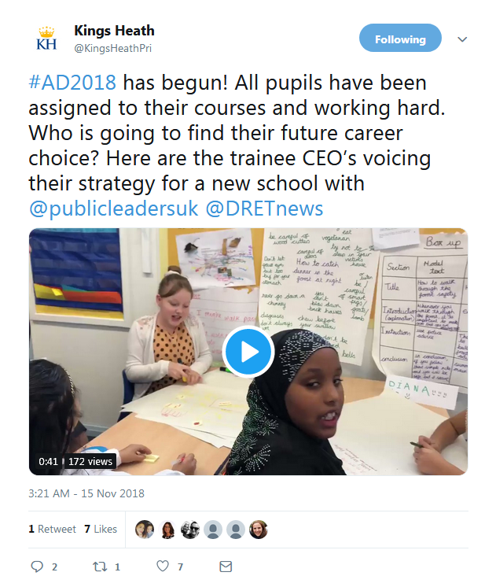
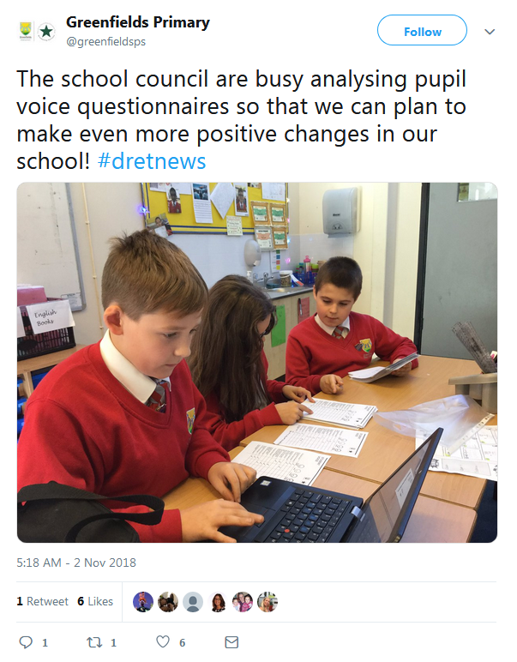
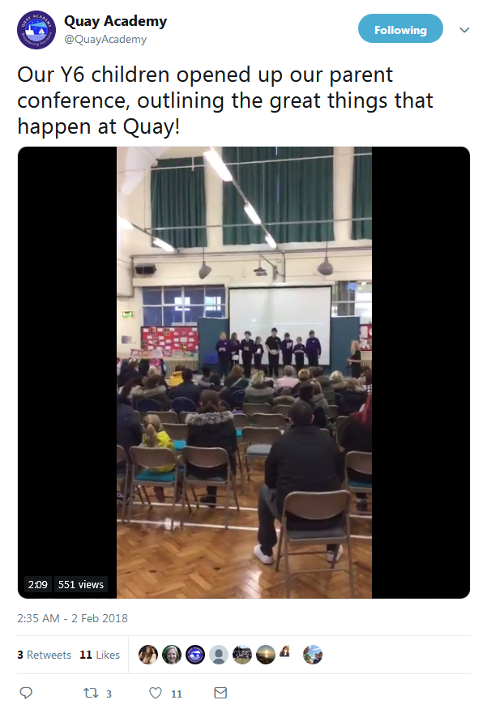
Impact on Pupils

Slide 16
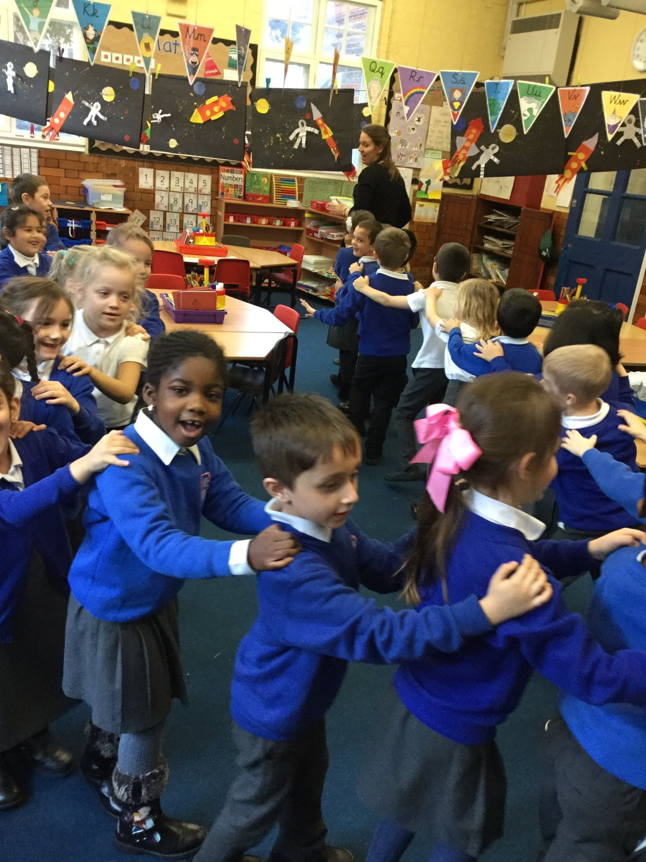
Questions and Discussion

Slide 17
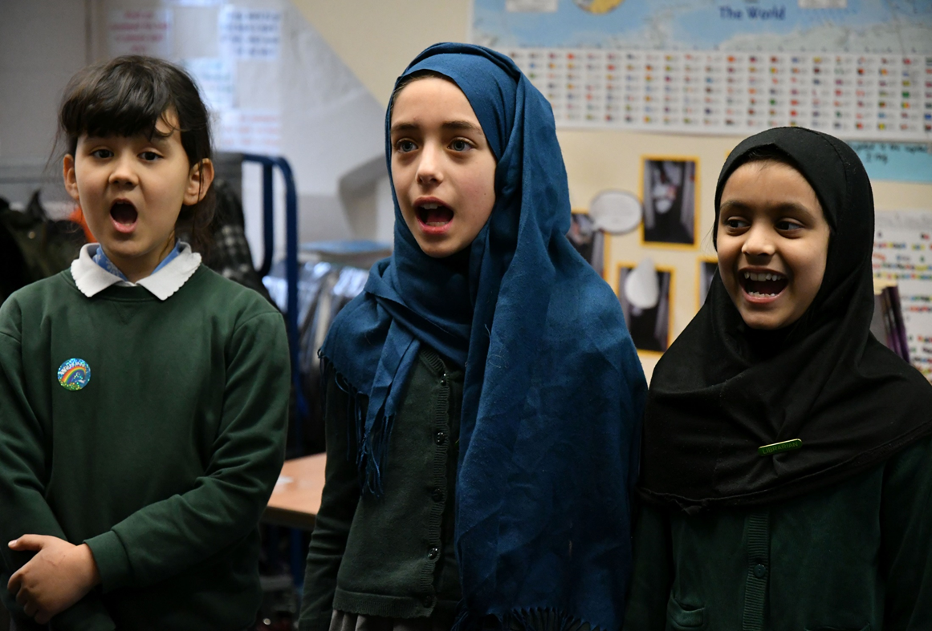
Thank you!
Edward Milner
Interim CEO
The Voices Foundation
edward.milner@voices.org.uk
Simon Toyne
Executive Director of Music
David Ross Education Trust
stoyne1@dret.co.uk
www.voices.org.uk vf@voices.org.uk @Voices_Found

